Slide 1
机器人与人工智能实验室 Robotics and Artificial Intelligence Laboratory
WELCOME TO

Slide 2
On-Board EEPROM
1. Introduction
The AT24C32D memory chip is a two-wire serial EEPROM chip of Atmel with a capacity of 4096 x 8bits, or 32k bits.
Equipped with the I2C communication interface, the chip integrated on the board mainly stores the gait and posture data of the cat.

Slide 3
On-Board EEPROM
Read 5 bytes of data from the chip's address 0, and then read another 5 bytes. It can be seen that when the 5 bytes of data are read for the second time, the previous 5 bytes continue to be read automatically.
In other words, when reading data repeatedly, we don't need to always write the address. Because the address will automatically move down.

Slide 4
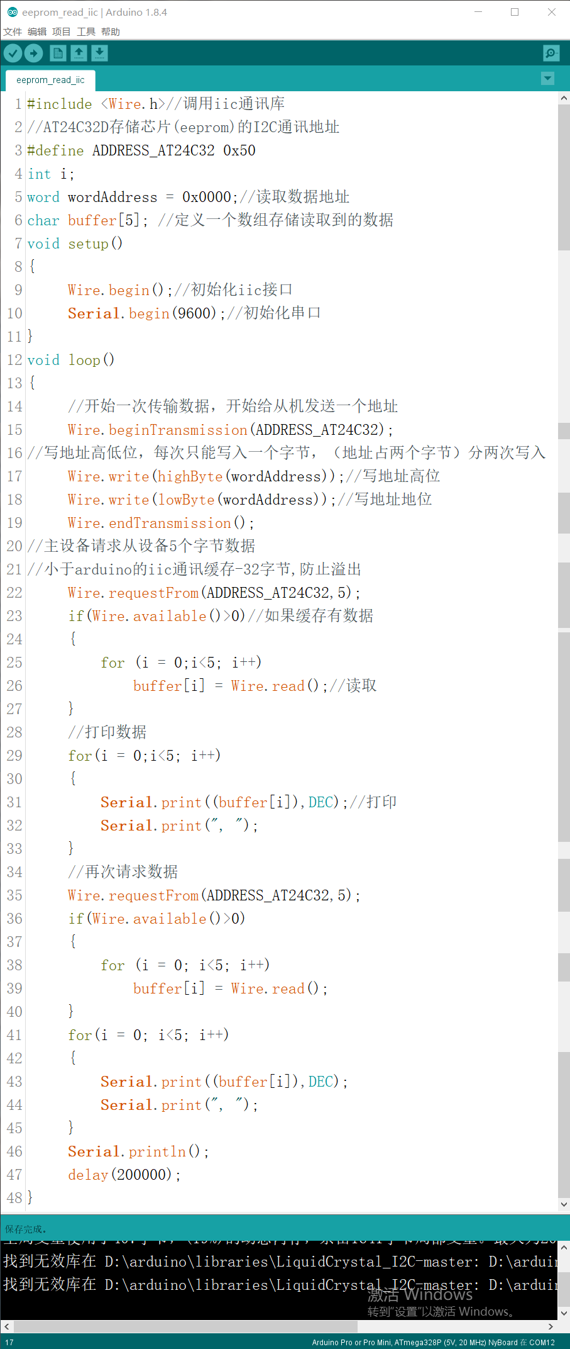
On-Board EEPROM
2. Coding (Read data)

Slide 5
On-Board EEPROM
Next:

Slide 6
On-Board EEPROM
Next:

Slide 7
On-Board EEPROM
3. Uploading
Open the serial port, the specific information of the first skill is read. It is exactly the same as the data in the Instinct.h file.
This is ready for the next step we directly read the EEPROM data of the IIC interface for gait control.

Slide 8
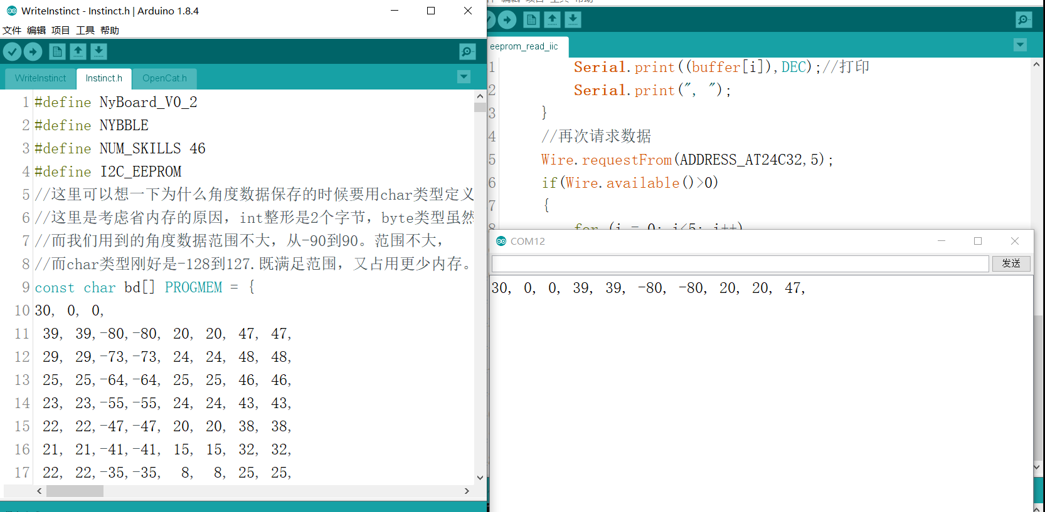
On-Board EEPROM
4. Result

Slide 9
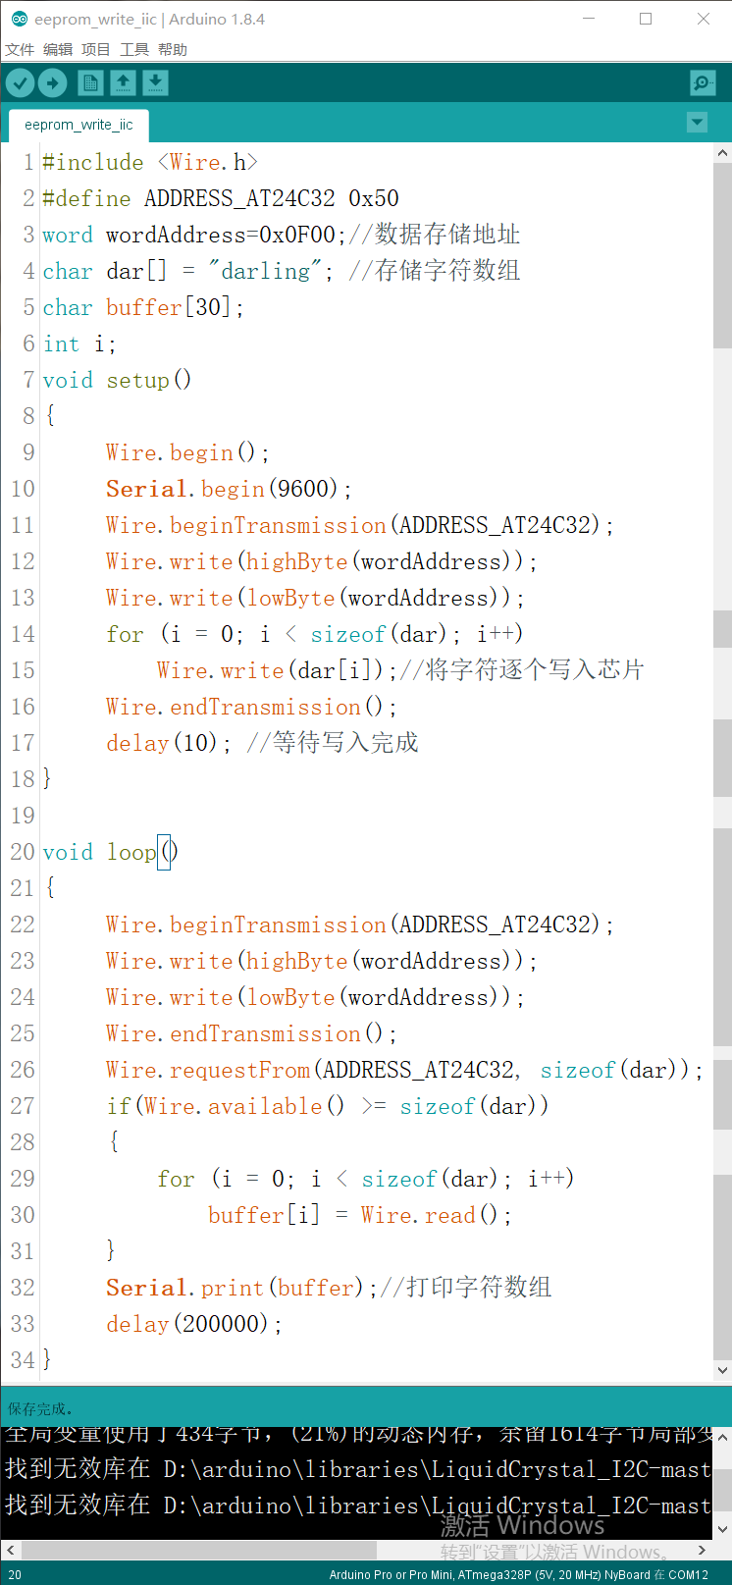
On-Board EEPROM
The specific code and comments for writing data:

Slide 10
On-Board EEPROM
Next:

Slide 11
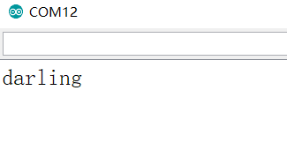
On-Board EEPROM
Open the serial port. The stored character array is successfully output:

Slide 12

THANK YOU
林天麟 教授
香港中文大学（深圳）
机器人与人工智能实验室
WeChat: tinlunlam

